Slide 1
Hexaware Cloudify Everything Hackathon
Geek Goddess 2019
Presentation Topic
Mining Online Reviews using Topic Modeling(LDA)

Slide 2

Brief explanation of idea what makes it unique And the Problem being Solved :
Online product reviews are a great source of information for consumers. From the sellers’ point of view, online reviews can be used to gauge the consumers’ feedback on the products or services they are selling. However, since these online reviews are quite often overwhelming in terms of numbers and information, an intelligent system, capable of finding key insights (topics) from these reviews, will be of great help for both the consumers and the sellers. This system will serve two purposes:
1. Enable consumers to quickly extract the key topics covered by the reviews without having to go through all of them
2. Help the sellers/retailers get consumer feedback in the form of topics (extracted from the consumer reviews)

Slide 3
What is used:
Machine Learning
LDA Topic Modeling
Amazon Sagemaker

Slide 4
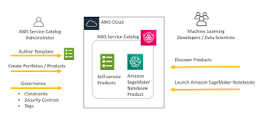
Technical architecture

Slide 5
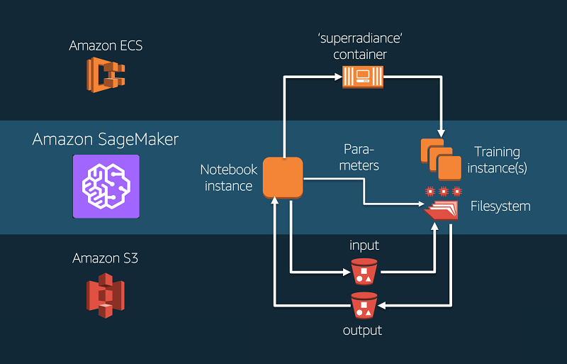
Technology/Tool Stack

Slide 6
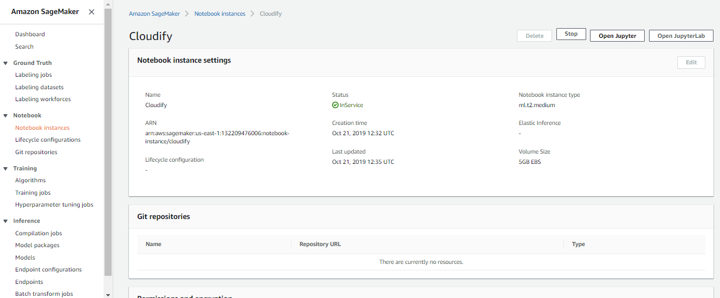
Prototype Demo(Video/Screenshots)

Slide 7
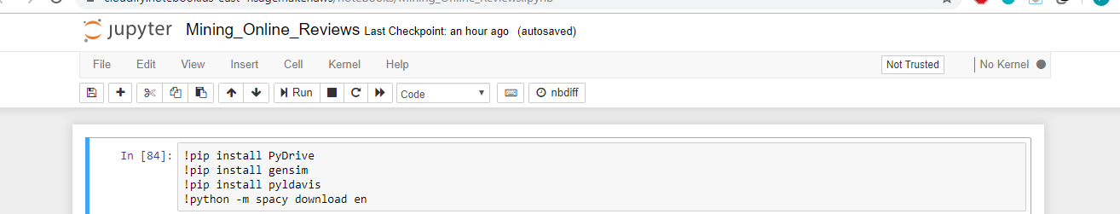
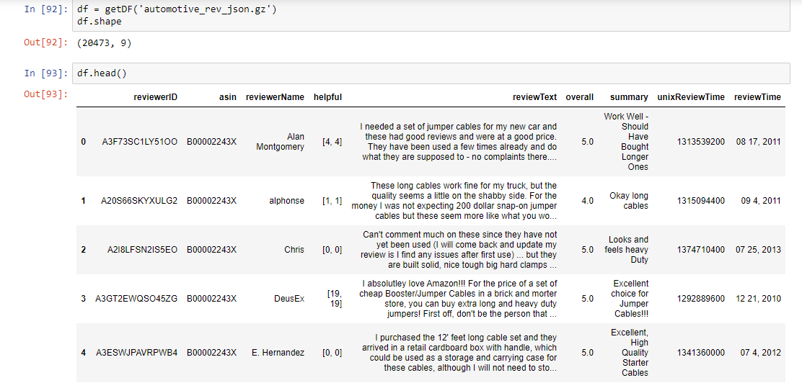

Slide 8
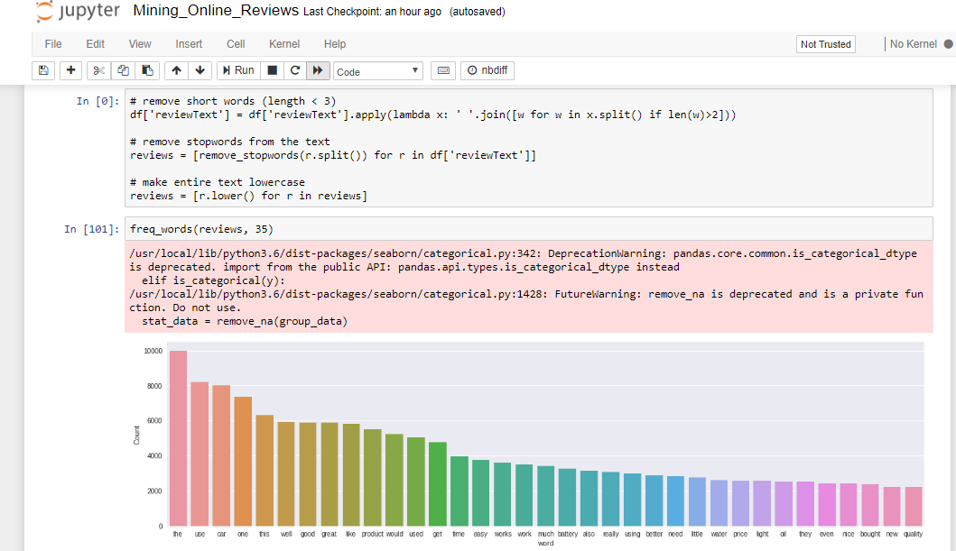

Slide 9
Need to solve this problem
There are cases where customers take the e-commerce plunge and purchase a smartphone online. It happens to be well within budget, and it may hae an above decent rating of 4.5 out of 5.
Unfortunately, it turns out to be a bad decision as the battery backup was well below par. The customer might didn’t go through the reviews of the product and made a hasty decision to buy it based on its ratings alone.
Ratings alone do not give a complete picture of the products we wish to purchase. So, as a precautionary measure, it is always advisable to people to read a product’s reviews before deciding whether to buy it or not.
But then an interesting problem comes up. What if the number of reviews is in the hundreds or thousands? It’s just not feasible to go through all those reviews, right?
And this is where I have come up with a solution.

Slide 10


